Slide 1
Behov
Tar med egen PC for å presentere med

Slide 2




Mens vi venter
Gå til https://fama-social-feed.web.app
Denne Jodel klonen vil bli brukt som eksempel i presentasjonen. Så det er bare å gå inn å prøve den ut
Firebase
https://gaute.dev
GauteMeekOlsen
Notes:
https://fama-social-feed.web.app

Slide 3
Hva er Firebase og hvordan er forholdet mellom Firebase og Google Cloud?
Gaute Meek Olsen
02.11.2019
https://gaute.dev
GauteMeekOlsen

Slide 4
Agenda
Firebase er kult!
Hva er Firebase?
Eksempler av mest brukte produkter
Pris
Firebase sin plass i Google Cloud Platform
https://gaute.dev
GauteMeekOlsen

Slide 5









Hvem er jeg - stats
Gaute Meek Olsen
2 firebase summits
238 followers
3,25 år
400 views i uka
https://gaute.dev
8 apper
30 views i uka
17 webprosjekter
https://gaute.dev
GauteMeekOlsen

Slide 6

Hva er Firebase?
Forsøk nr. 1
Firebase is Google’s application development platform
that helps you
build, improve, and grow your app.
Platform as a service
Backend as a service
https://gaute.dev
GauteMeekOlsen

Slide 7


Hva er Firebase?
Forsøk nr. 2
DEG
Firebase
https://gaute.dev
GauteMeekOlsen

Slide 8


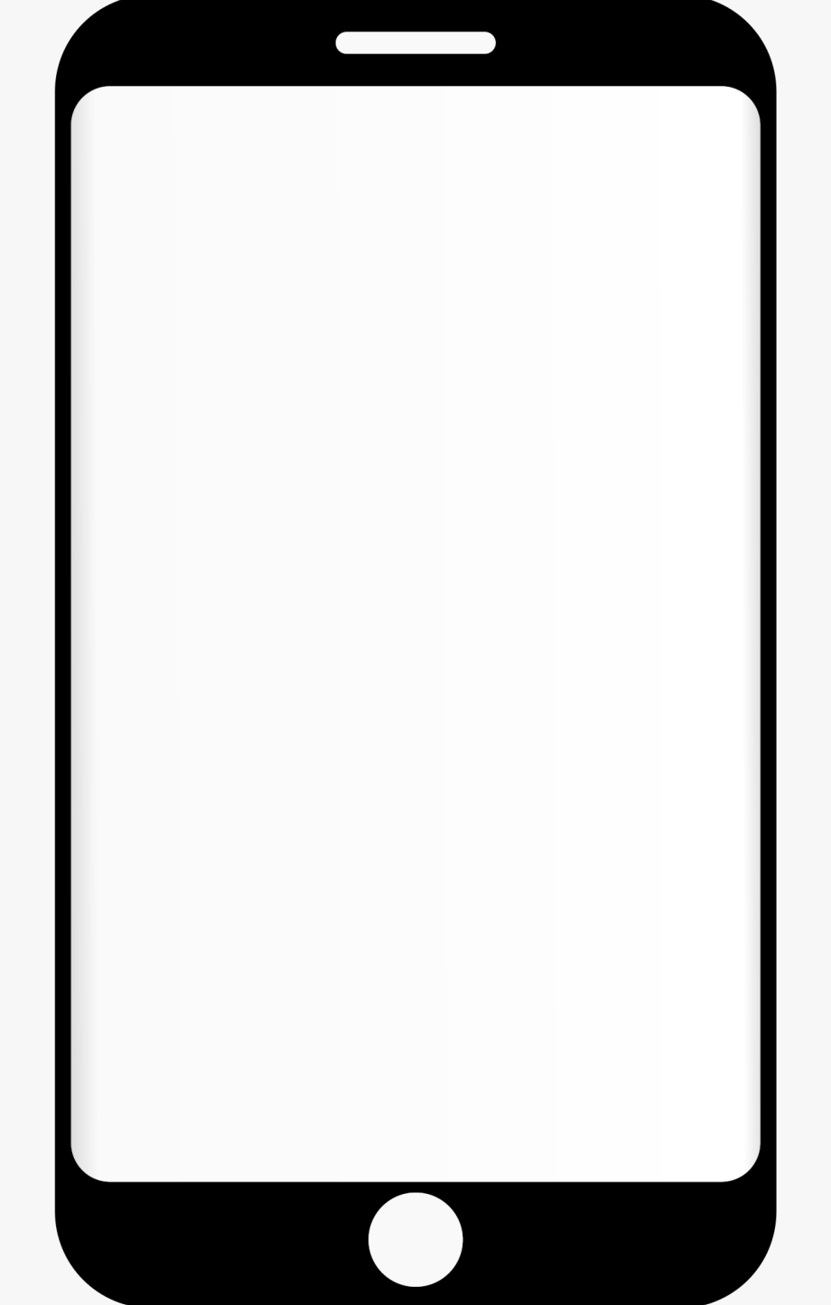
Men først la oss gå tilbake
Forsøk nr. 3
Backend
Frontend
https://gaute.dev
GauteMeekOlsen

Slide 9
Mer av dette nå
Forsøk nr. 3
Backend
Frontend
https://gaute.dev
GauteMeekOlsen

Slide 10

Firebase sin måte
Forsøk nr. 3
Backend
Frontend
SDK
https://gaute.dev
GauteMeekOlsen
Notes:
Det vil si at man kun trenger å kalle på en metode, så vil alt annet håndteres av Firebase

Slide 11





Firebase sin måte
Forsøk nr. 3
Frontend
Backend
SDK
Backend
Admin SDK
https://gaute.dev
GauteMeekOlsen
Notes:
Det vil si at man kun trenger å kalle på en metode, så vil alt annet håndteres av Firebase

Slide 12
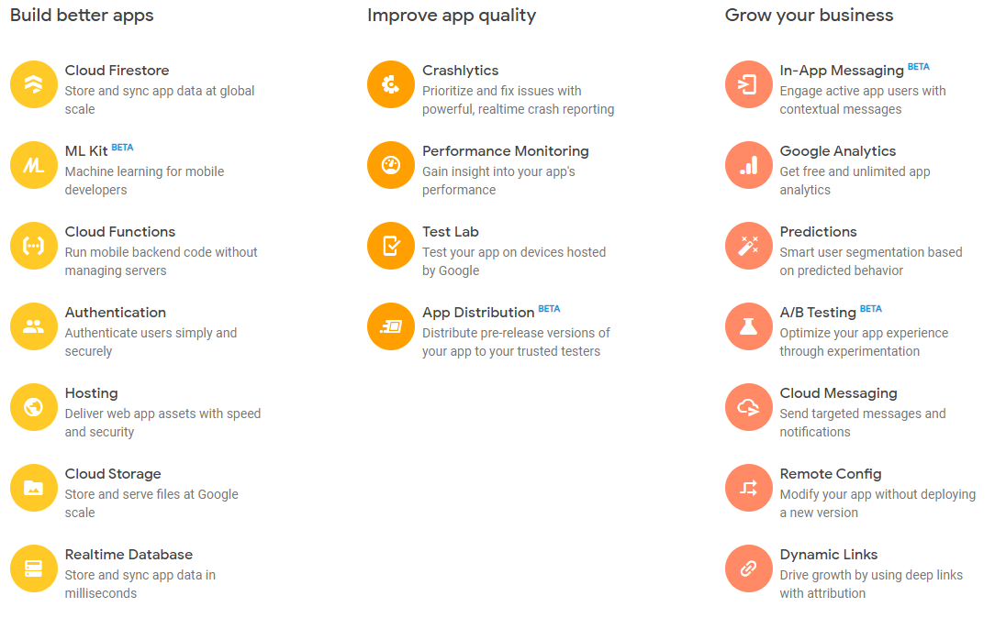
Firebase
Forsøk nr. 4

Slide 13
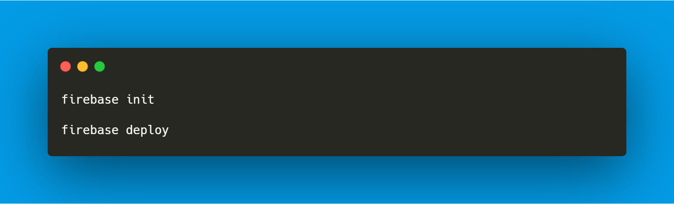
Hosting
https://gaute.dev
GauteMeekOlsen

Slide 14
La oss se på consolen
https://gaute.dev
GauteMeekOlsen
Notes:
https://console.firebase.google.com/

Slide 15
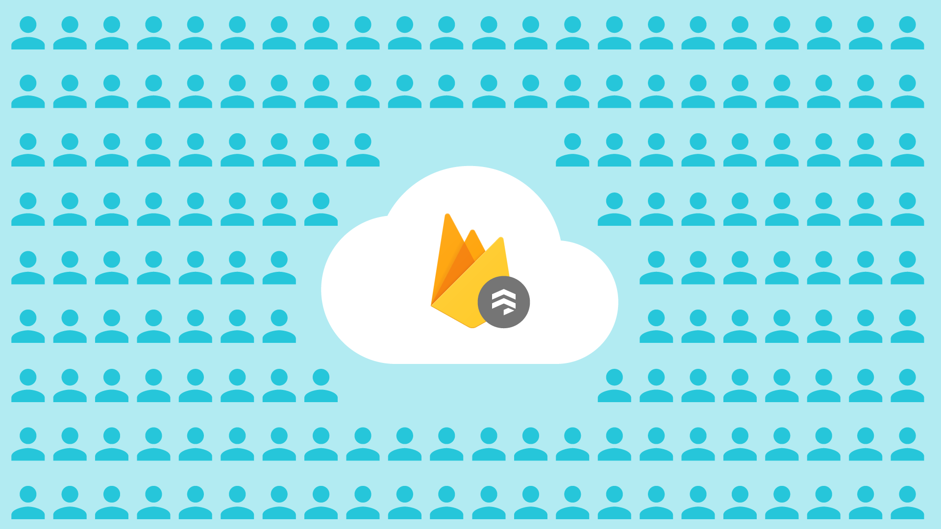
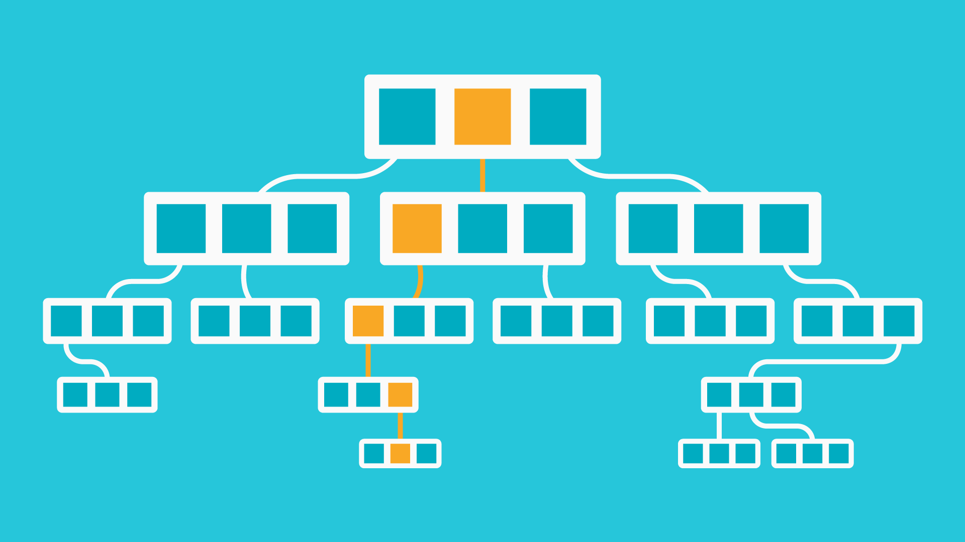
Firestore
NoSQL
Serverless
Offline support
Realtime
Notes:
https://console.firebase.google.com/project/fama-social-feed/database/firestore/

Slide 16
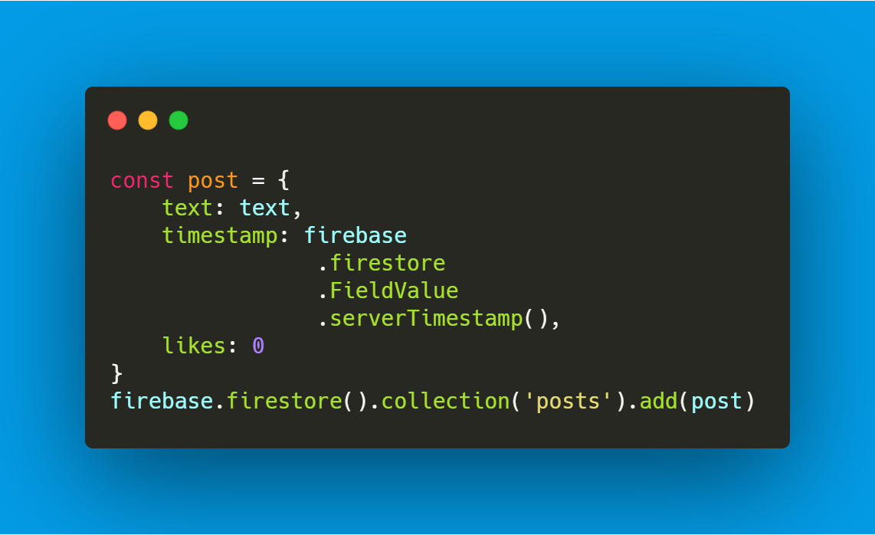
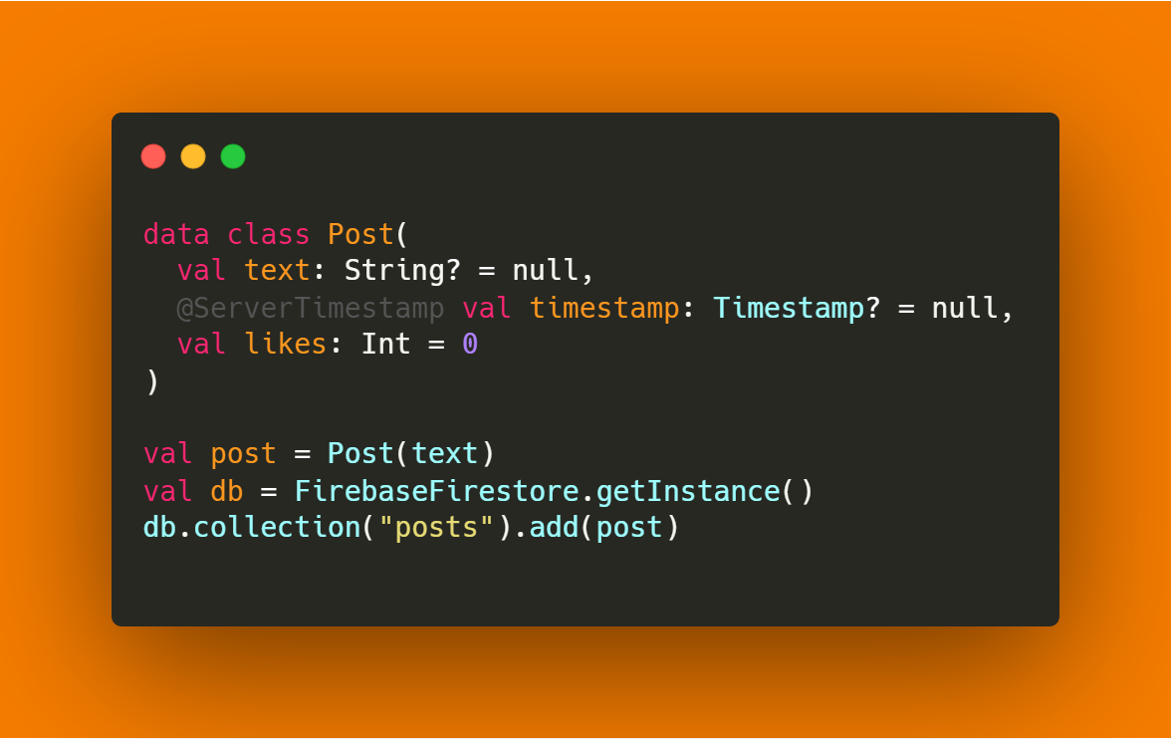
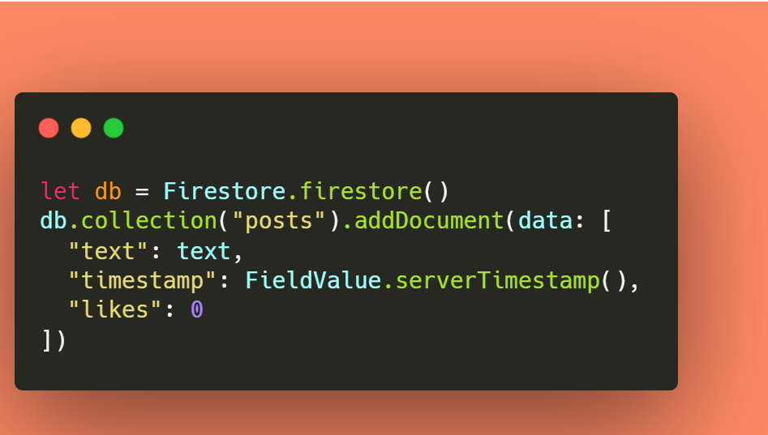

Firestore (add)
JavaScript
Kotlin
Swift
https://gaute.dev
GauteMeekOlsen

Slide 17
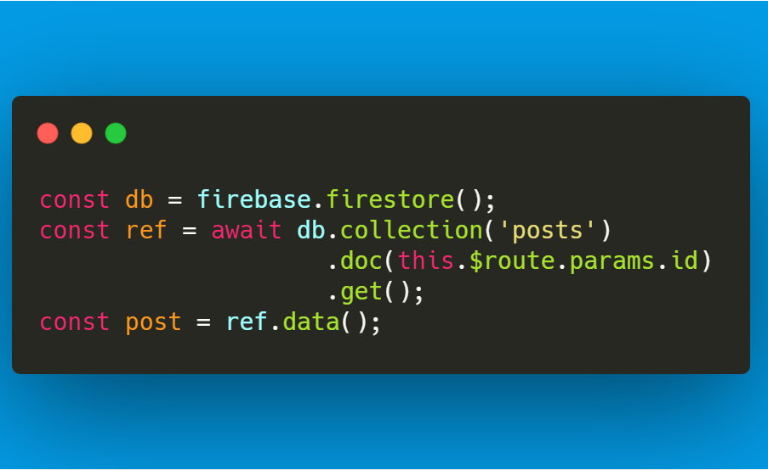
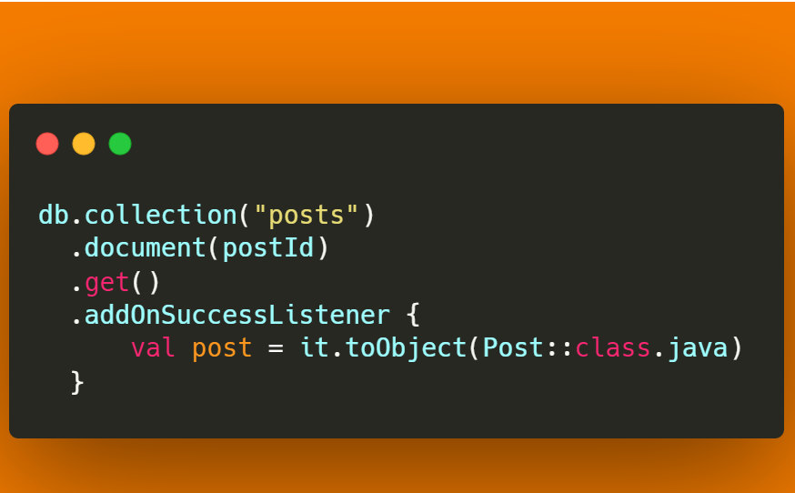
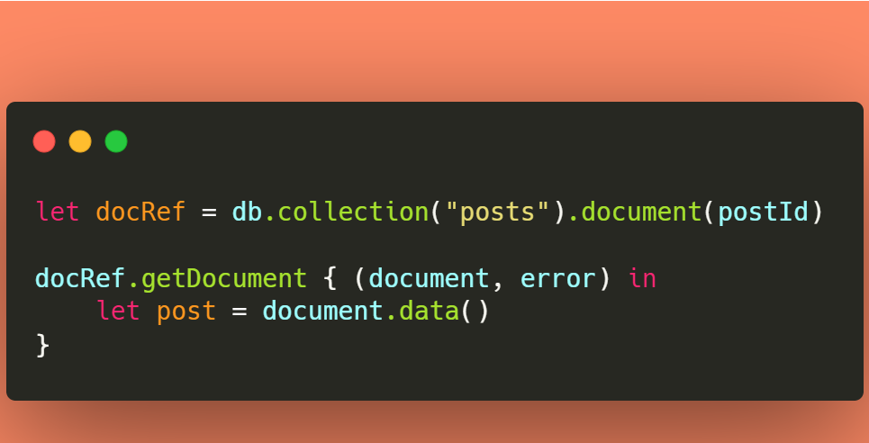
Firestore (read)
JavaScript
Kotlin
Swift
https://gaute.dev
GauteMeekOlsen

Slide 18
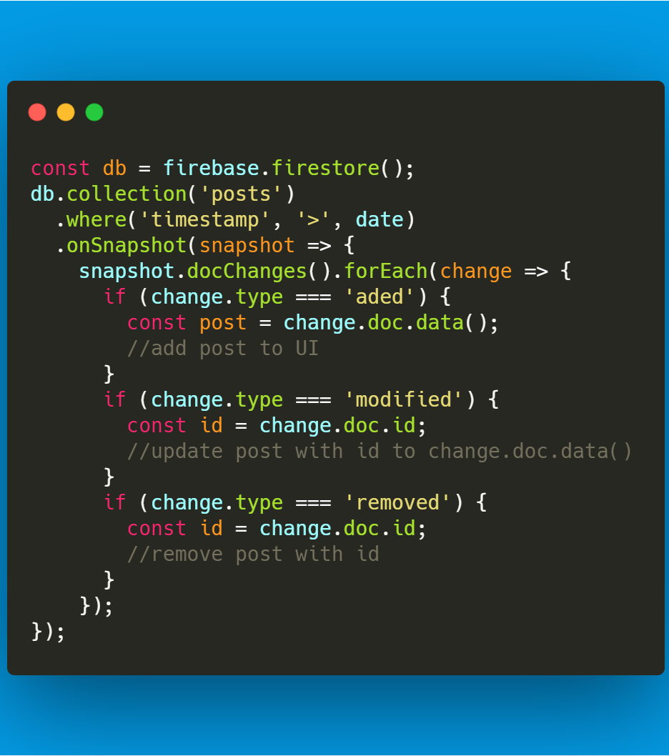
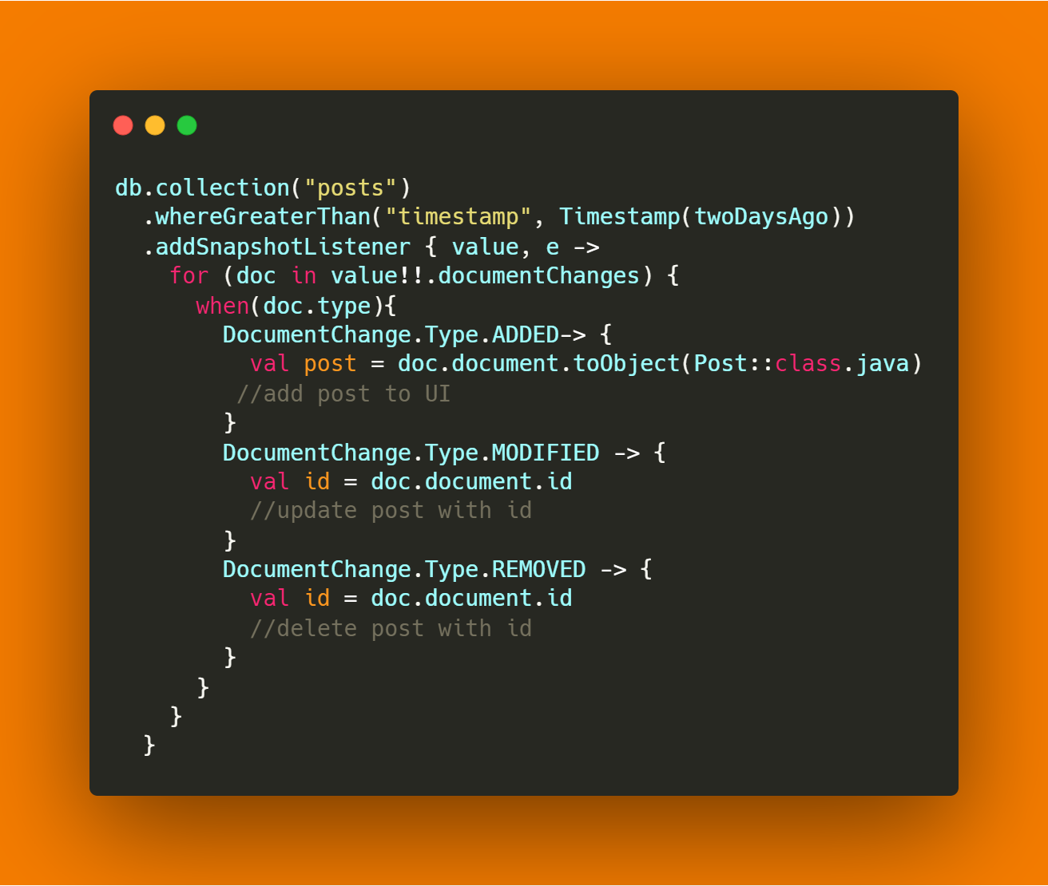
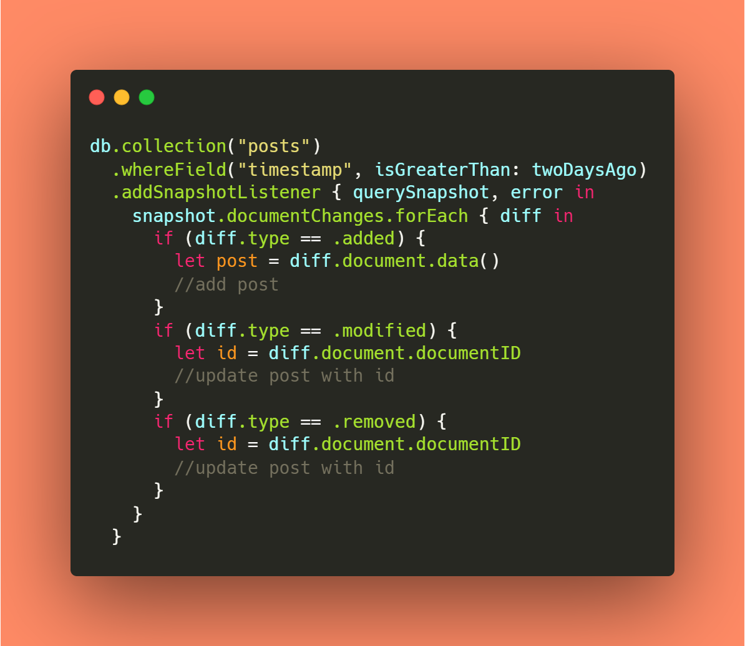
Firestore (real time)
JavaScript
Kotlin
Swift

Slide 19
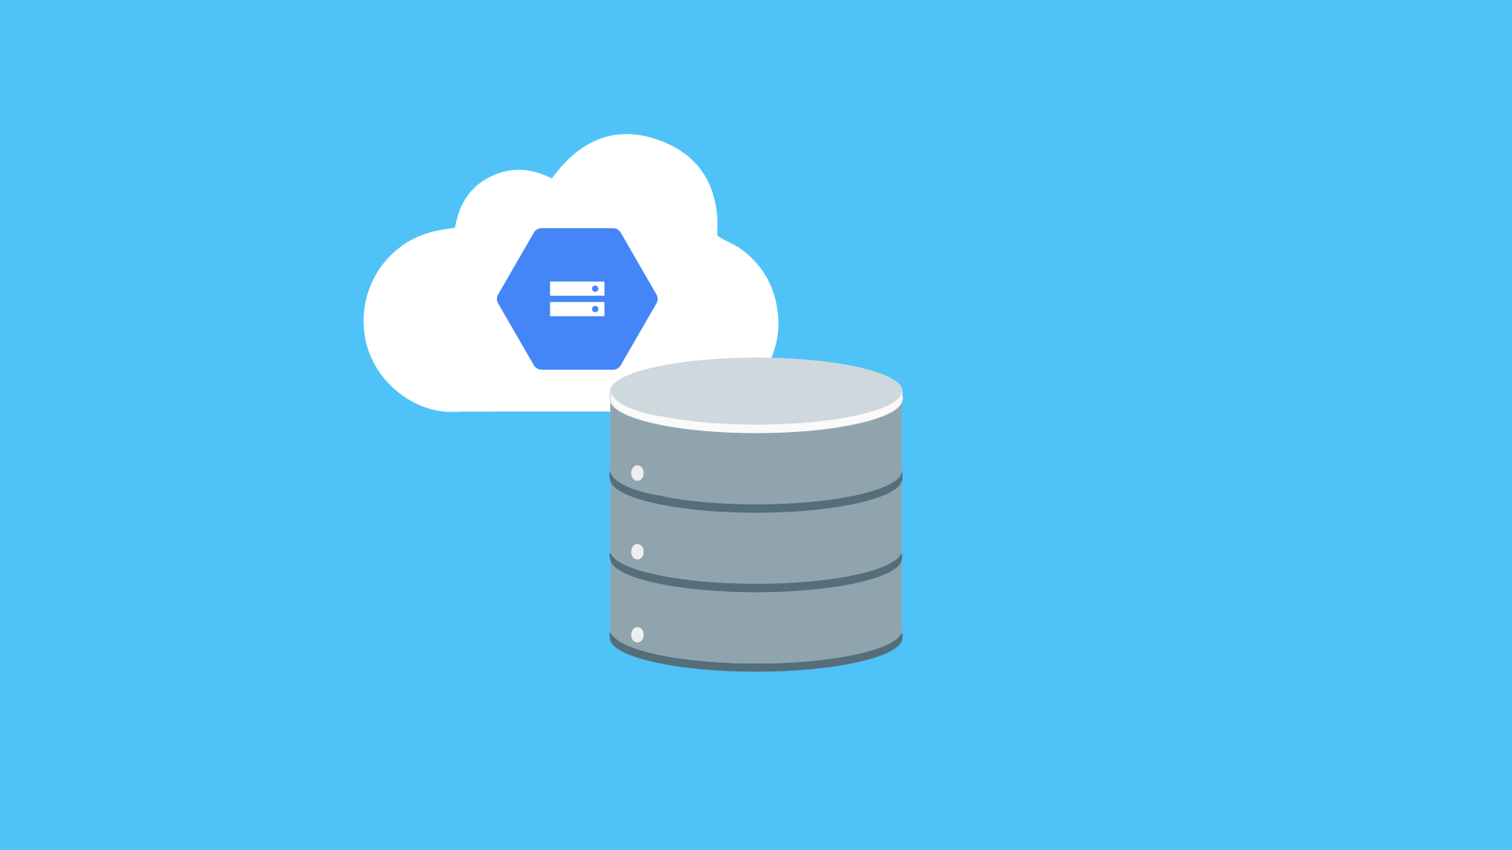
Cloud Storage
Filer
https://gaute.dev
GauteMeekOlsen

Slide 20
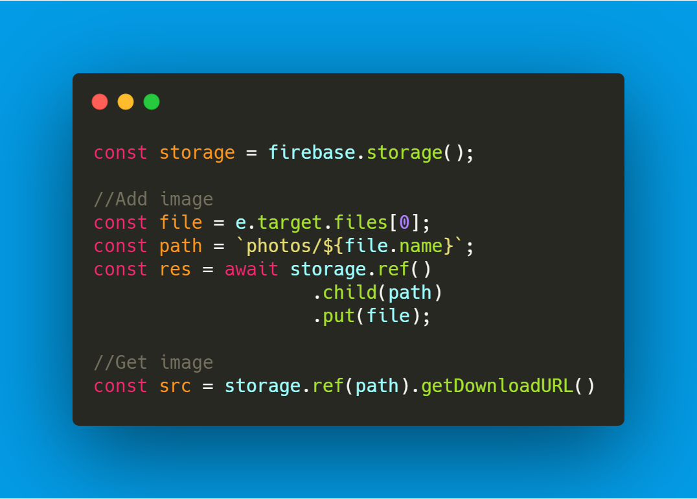
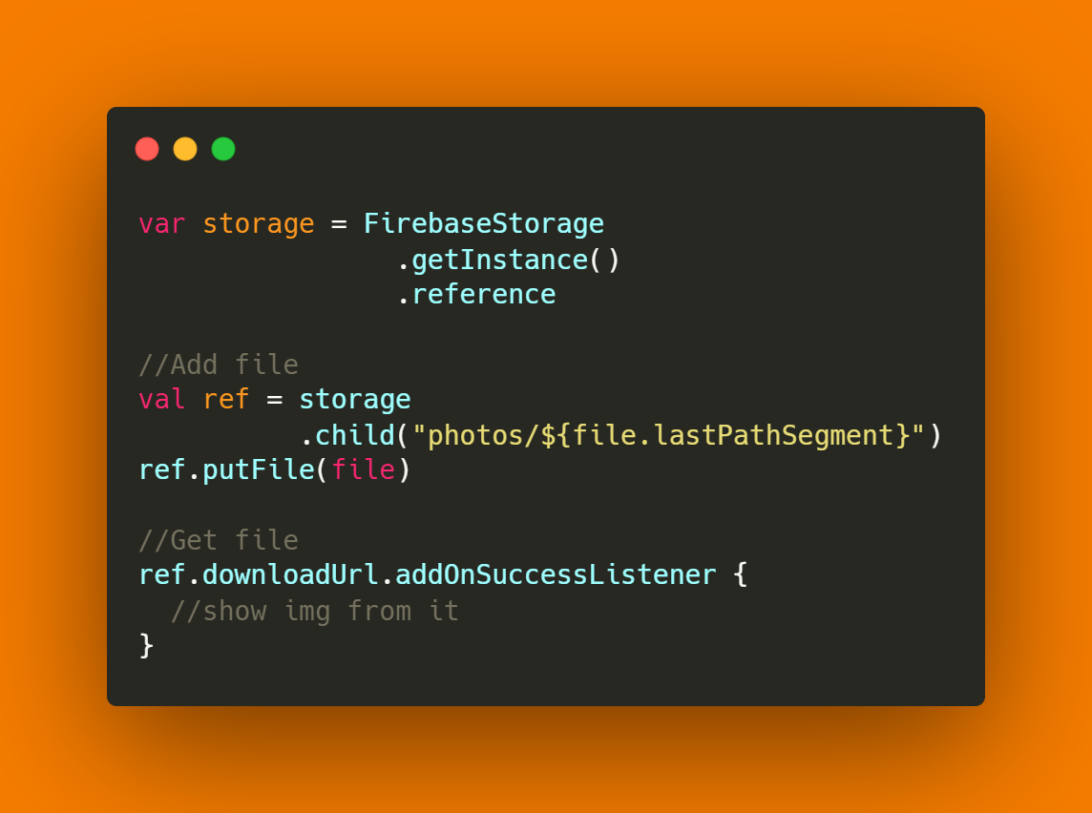
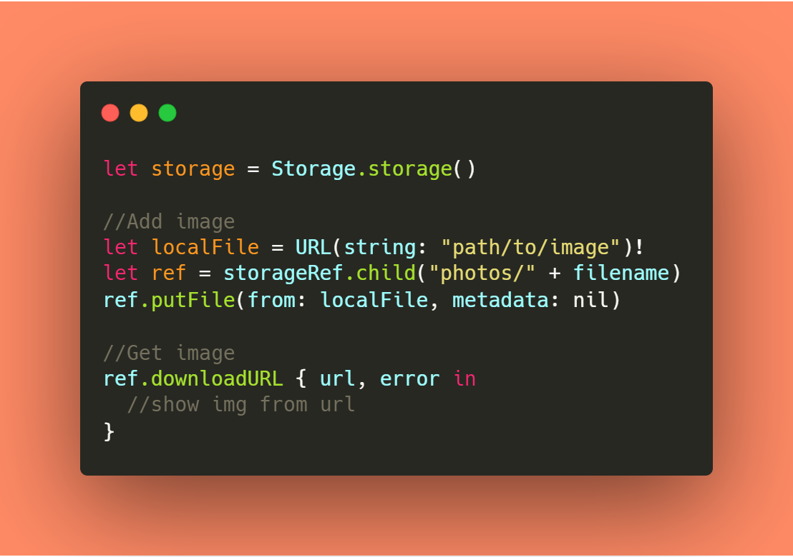
Cloud Storage
JavaScript
Kotlin
Swift
https://gaute.dev
GauteMeekOlsen

Slide 21
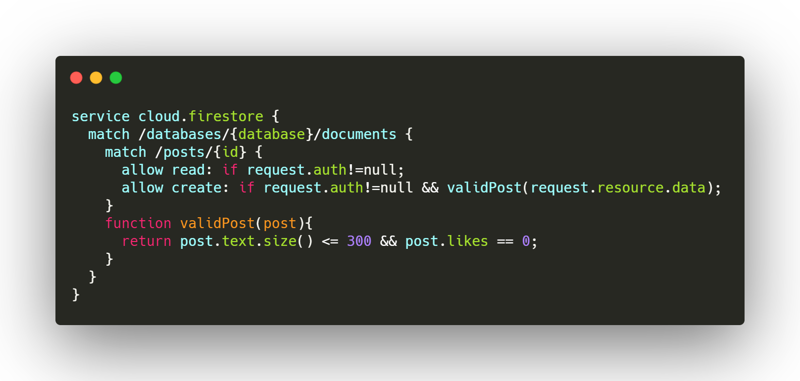
Rules
https://gaute.dev
GauteMeekOlsen

Slide 22
Authentication
La Google ta seg av bruker- og passordhåndtering
Flere providers:
Email
SMS
Google
Facebook
Twitter
Anonym
GitHub
Yahoo
Microsoft (Azure Active Directory and personal Microsoft accounts)
Play Games
Game Center
https://gaute.dev
GauteMeekOlsen
Notes:
https://console.firebase.google.com/project/fama-social-feed/authentication/providers

Slide 23
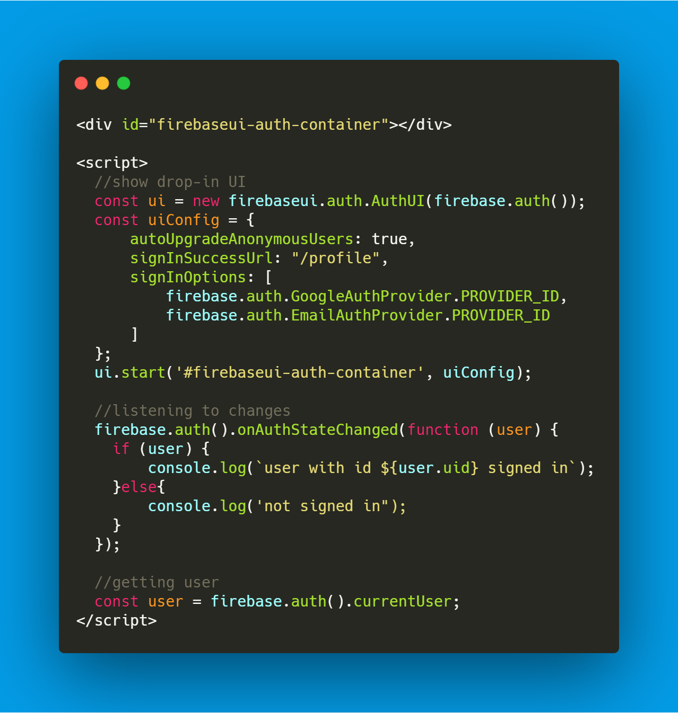
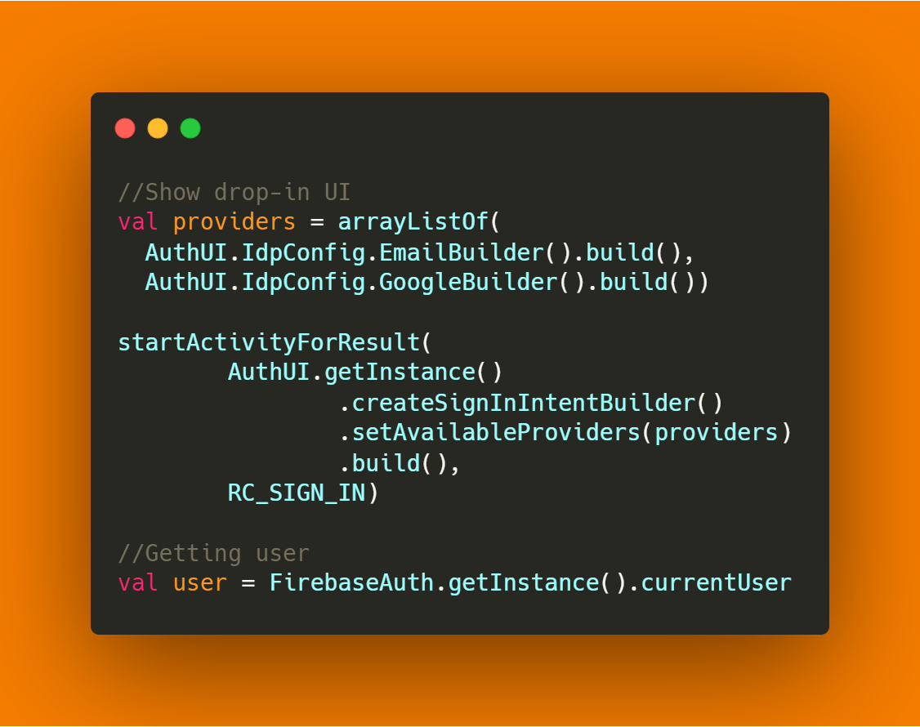
Authentication (drop-in UI)
HTM + JavaScript
Kotlin
https://gaute.dev
GauteMeekOlsen

Slide 24
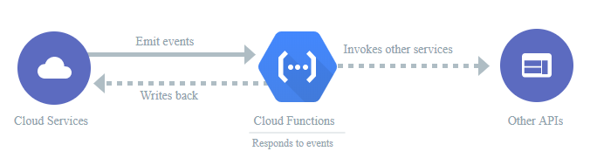
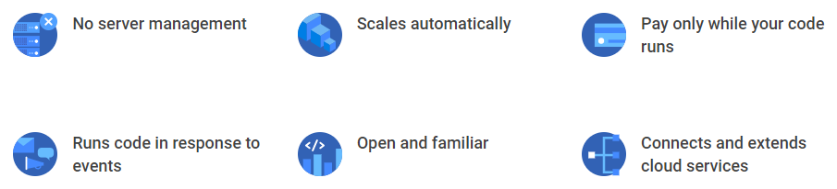
Cloud Functions
Code in the cloud, JavaScript eller TypeScript
Triggers:
HTTP
Firestore
Storage
Authentication
Google Analytics
Cloud Pub/Sub
Remote Config
Test Lab
Crashlytics
https://gaute.dev
GauteMeekOlsen

Slide 25
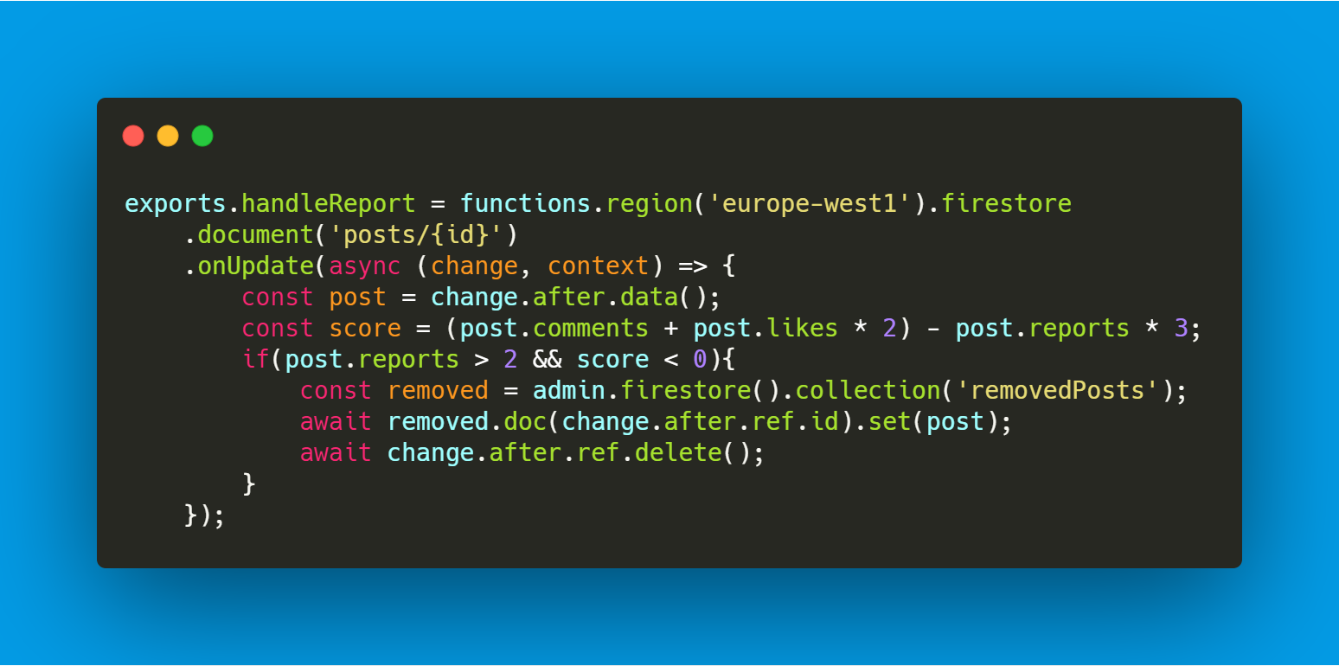

Cloud Functions
JavaScript

Slide 26
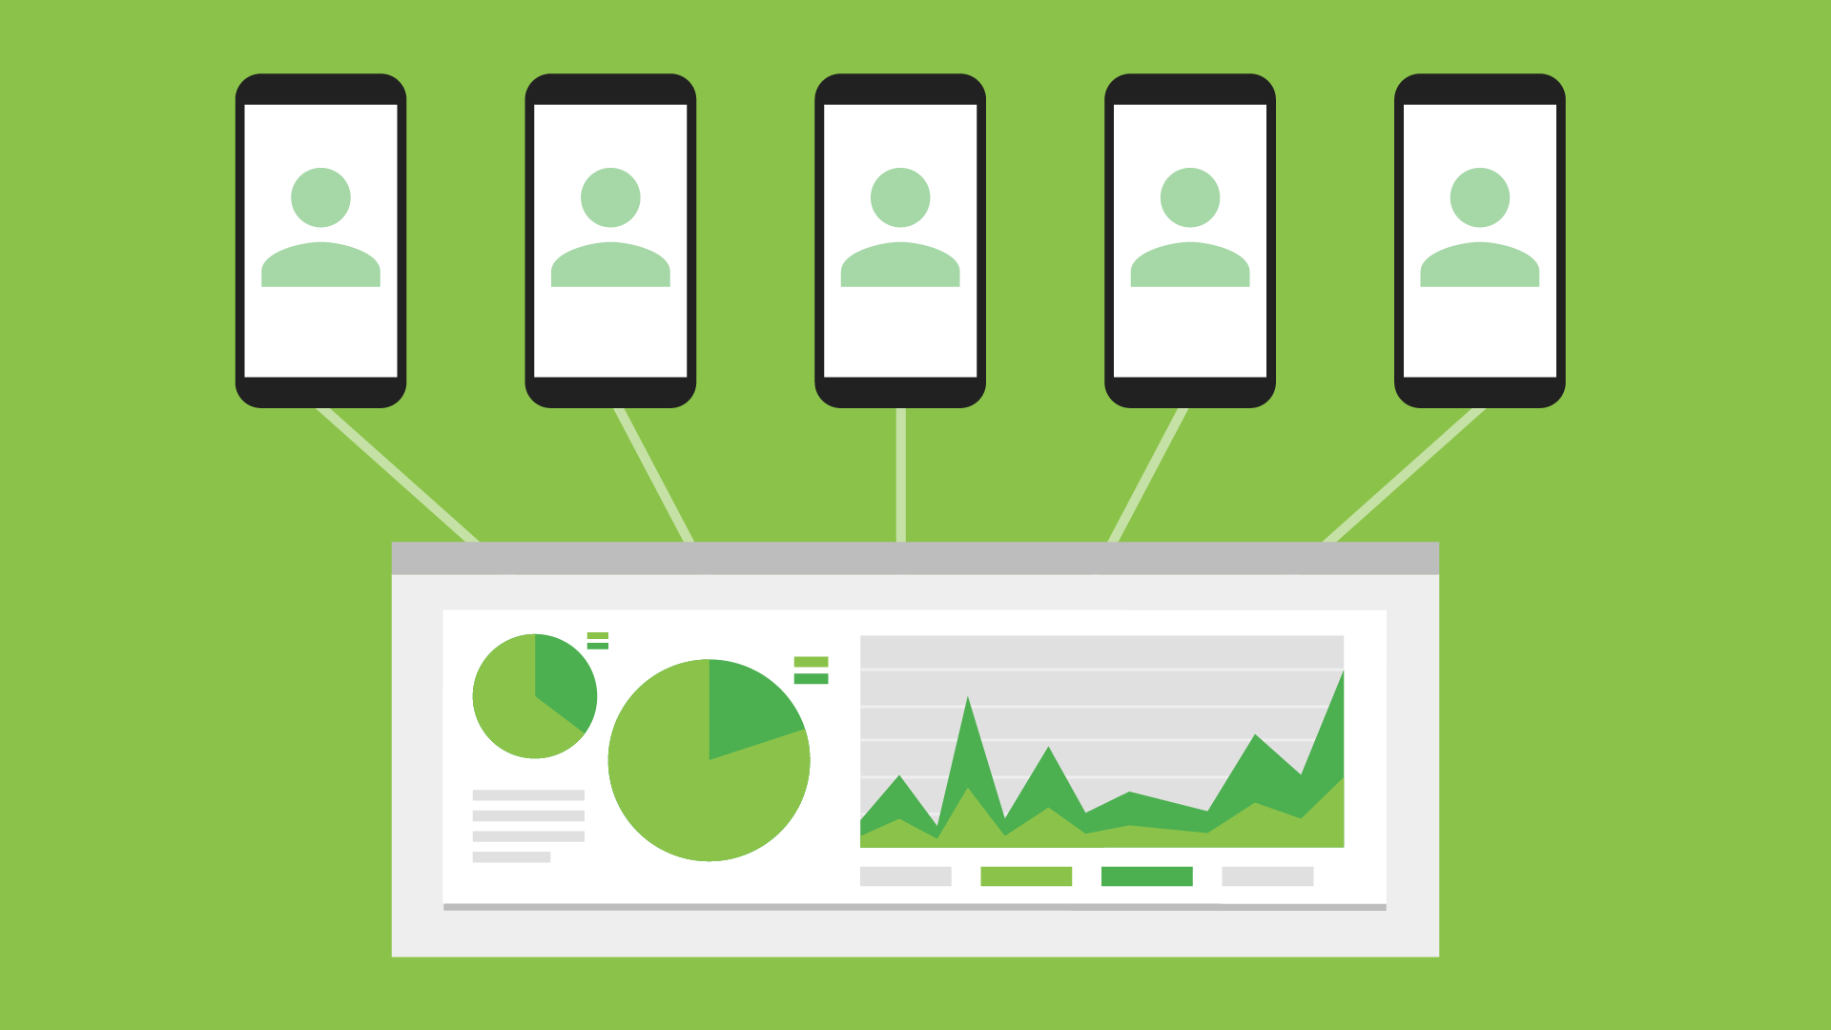
Performance Monitoring
https://gaute.dev
GauteMeekOlsen
Notes:
https://console.firebase.google.com/project/fama-social-feed/performance

Slide 27
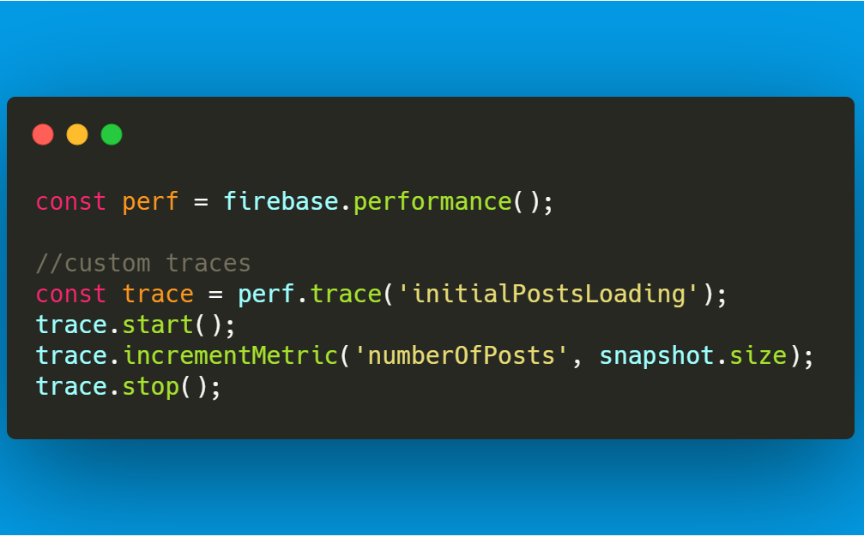
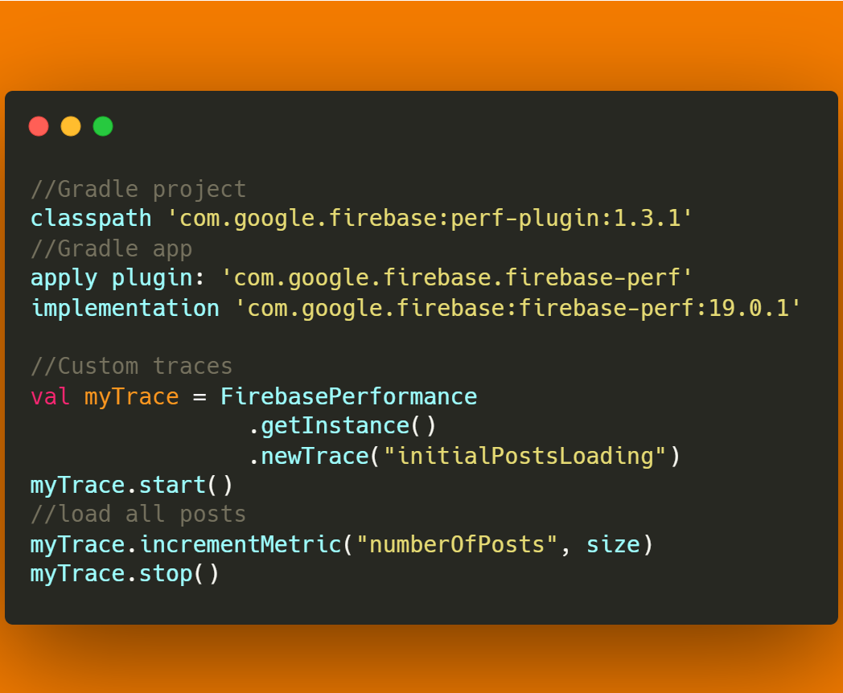
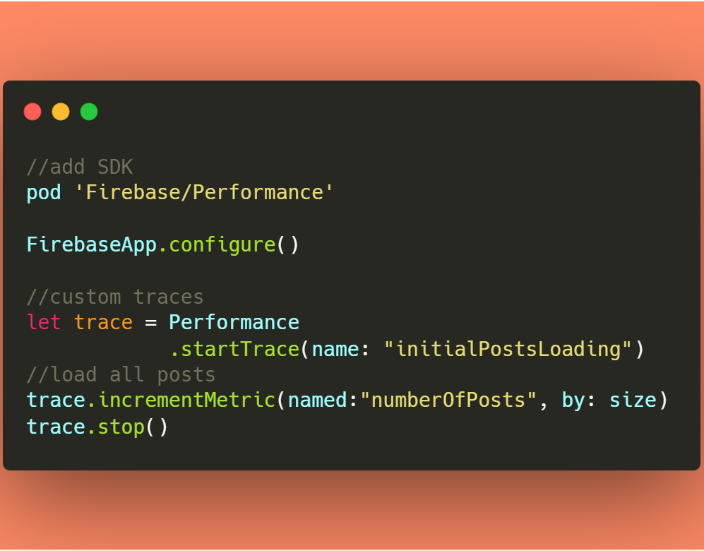
Performance Monitoring
JavaScript
Kotlin
Swift
https://gaute.dev
GauteMeekOlsen

Slide 28
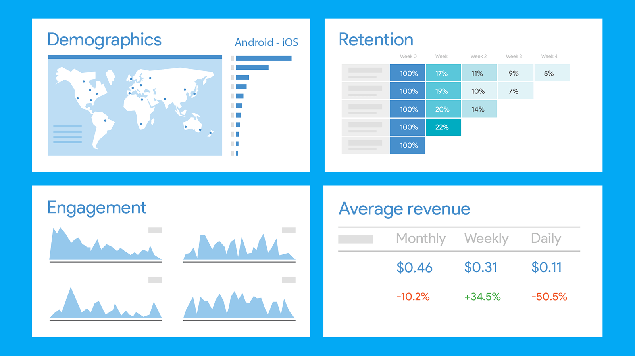
Google Analytics (Audiences + Funnels)
https://gaute.dev
GauteMeekOlsen
Notes:
https://console.firebase.google.com/project/fama-social-feed/analytics/app/web:YjE5Y2E5YTMtNDQxMy00NDcyLWE0ZjgtZWQ0MmIxYWFlZGRh/overview~2F%3Ft=1572549682924&fpn=676767442584&swu=1&sgu=1&sus=upgraded&cs=app.m.dashboard.overview&g=1
https://console.firebase.google.com/project/fama-social-feed/analytics/app/web:YjE5Y2E5YTMtNDQxMy00NDcyLWE0ZjgtZWQ0MmIxYWFlZGRh/overview
https://console.firebase.google.com/project/fama-social-feed/analytics/app/web:YjE5Y2E5YTMtNDQxMy00NDcyLWE0ZjgtZWQ0MmIxYWFlZGRh/funnels~2Foverview%3Ft=1572549943879&fpn=676767442584&swu=1&sgu=1&sus=upgraded&params=_u..pageSize%253D25&cs=app.m.funnels.overview&g=1
https://console.firebase.google.com/project/fama-social-feed/analytics/app/web:YjE5Y2E5YTMtNDQxMy00NDcyLWE0ZjgtZWQ0MmIxYWFlZGRh/audience~2Foverview%3Ft=1572549957694&fpn=676767442584&swu=1&sgu=1&sus=upgraded&params=_u..pageSize%253D25&cs=app.m.audiences.overview&g=1

Slide 29
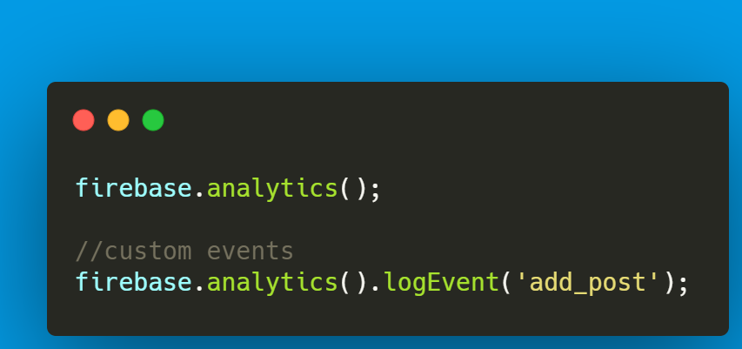
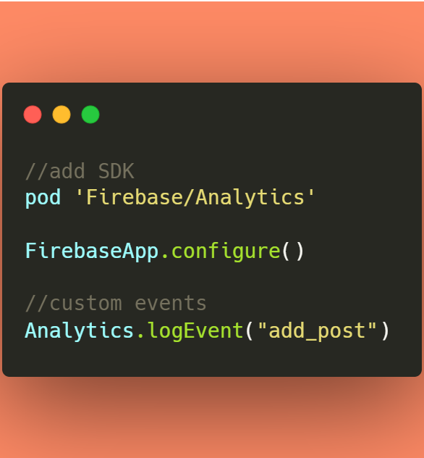
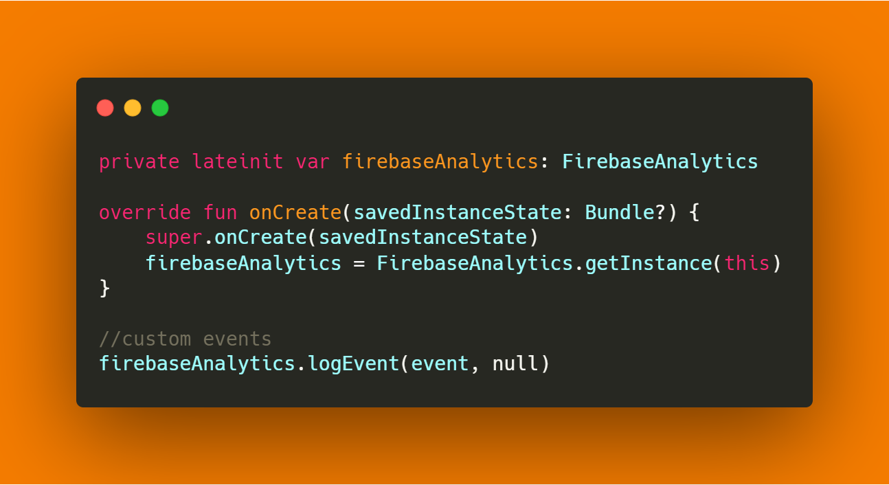
Google Analytics (Audiences + Funnels)
JavaScript
Swift
Kotlin
https://gaute.dev
GauteMeekOlsen

Slide 30
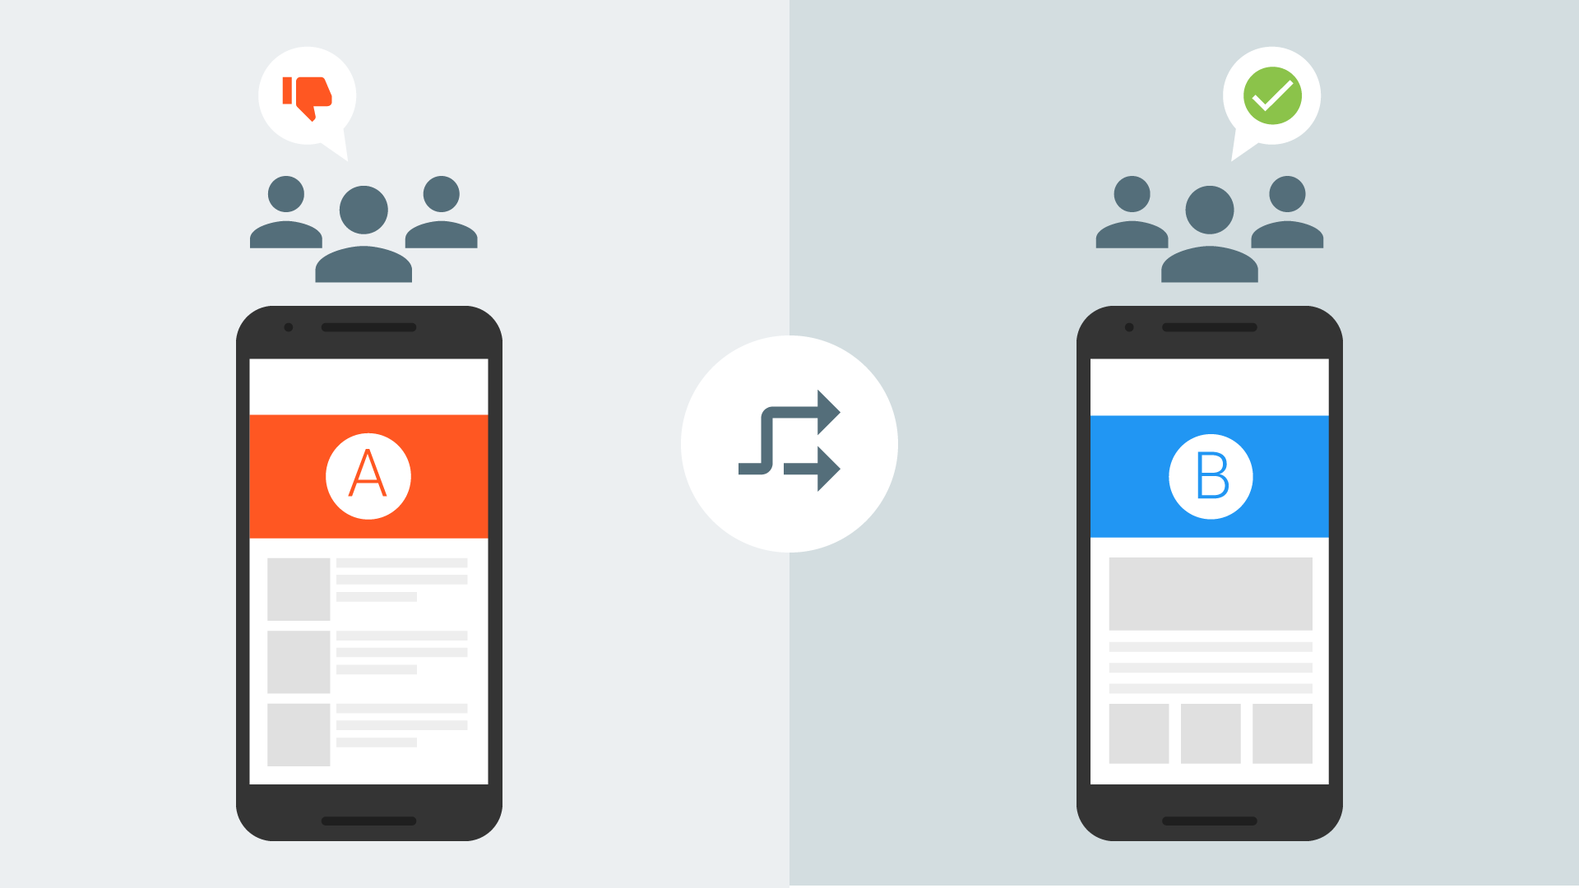
Remote Config
https://gaute.dev
GauteMeekOlsen
Notes:
https://console.firebase.google.com/project/fama-social-feed/config

Slide 31
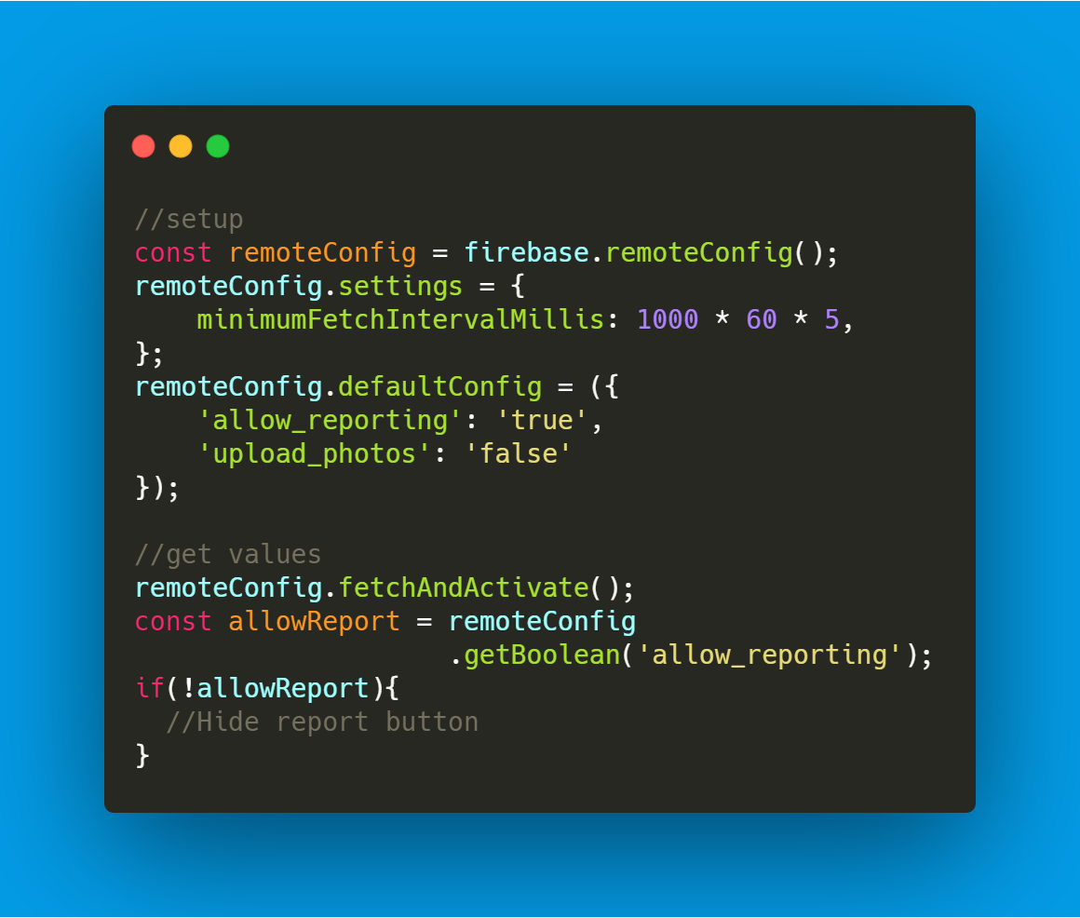
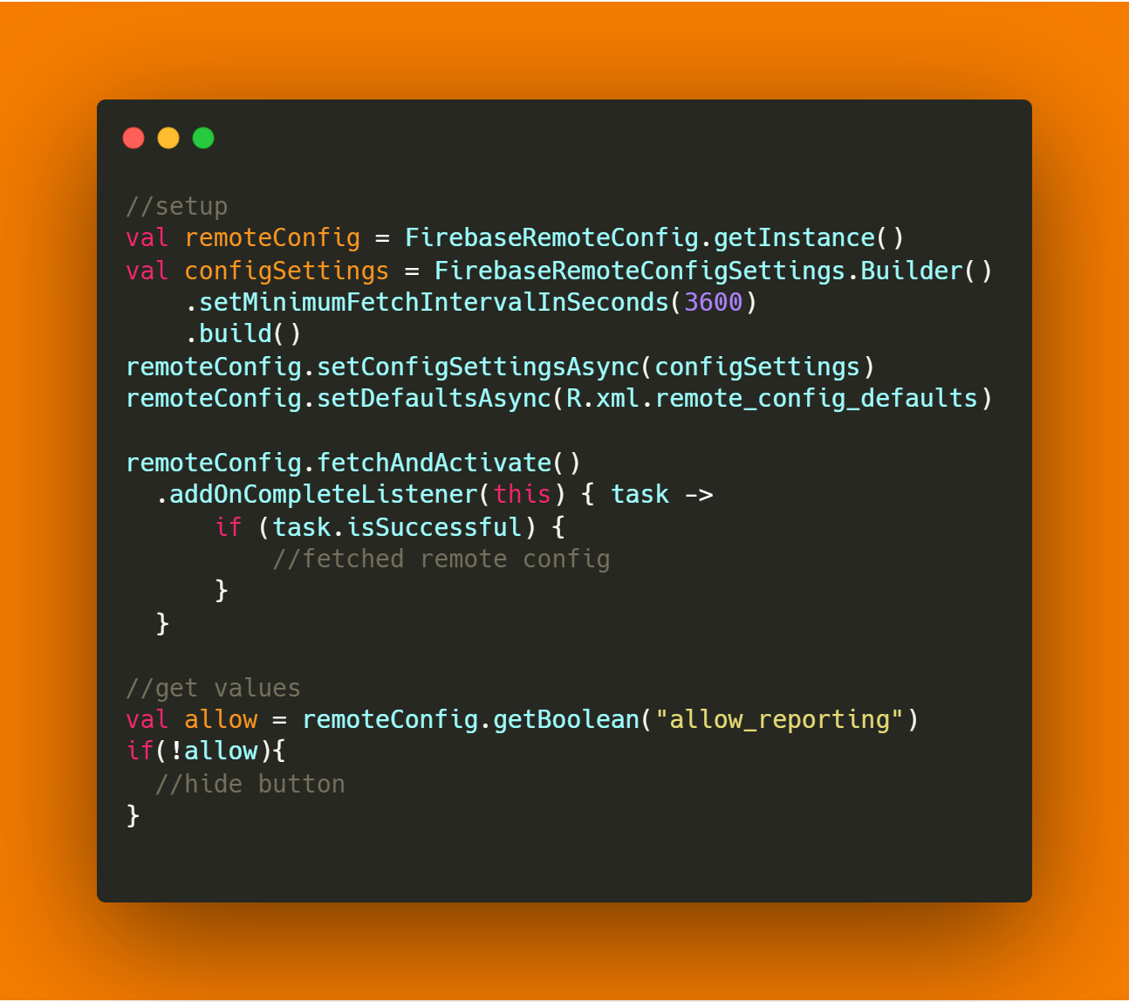
Remote Config
Kotlin
JavaScript

Slide 32
Firebase
Forsøk nr. 4
Notes:
https://firebase.google.com/products/ml-kit/
https://console.firebase.google.com/project/calc-fast-81457322/analytics/app/android:gautemo.game.calcfast/streamview%3Ft=1572551047861&fpn=961716258510&swu=1&sgu=1&sus=upgraded&cs=app.m.streamview.overview&g=1
https://console.firebase.google.com/project/calc-fast-81457322/crashlytics/app/android:gautemo.game.calcfast/issues?state=open&time=last-seven-days&type=crash

Slide 33
Pris
Generøs free tier
Hvis Firebase blir dyrt
Så har du en veldig populær applikasjon
Eller
Du har gjort noe feil
Eks. Firestore Free 20 000 writes daglig. $0.18/100 000
1 000 000 writes = $ 1.75 = 16 kroner
https://gaute.dev
GauteMeekOlsen

Slide 34
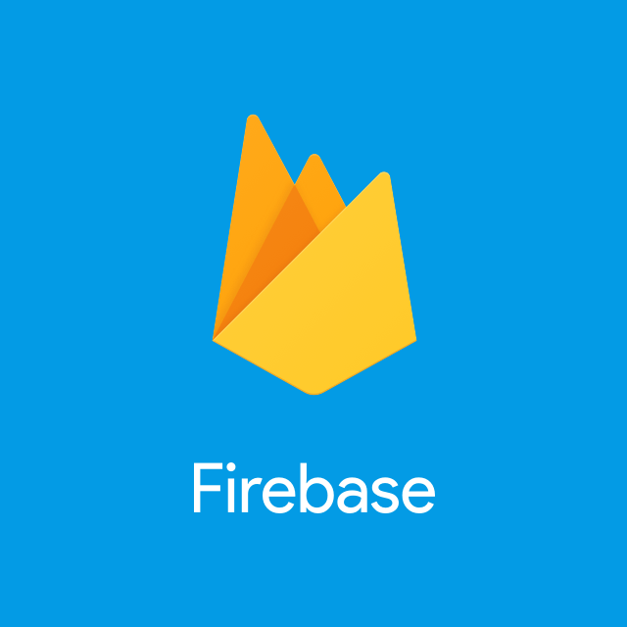

Firebase og Google Cloud
Hvert Firebase prosjekt er også et GCP
Hver Firebase service er hosted i GCP
Produkter som faktisk er GCP
Cloud Firestore
Cloud Storage
Cloud Functions

Slide 35
Konklusjon
Enkelhet
Du får fokusere på å utvikle applikasjonen
Skalerer med Google Cloud Platform
God dokumentasjon
Aktive i communityet
Enkel Firebase console adminpanel
https://gaute.dev
GauteMeekOlsen
Notes:
https://google.dev/
https://www.meetup.com/GDGOslo/events/265947127/

Slide 36
Thanks for watching
https://gaute.dev
www.soprasteria.no
GauteMeekOlsen

